Slide 1


Project name: Mesh Walkie Talkies Team members: Cole Cieslewicz, Ryan Haag, Jaiah Steele, Junsu Yeo
Project sponsor: Giuseppe Rizzi (TI)
ECEN 403

Slide 2
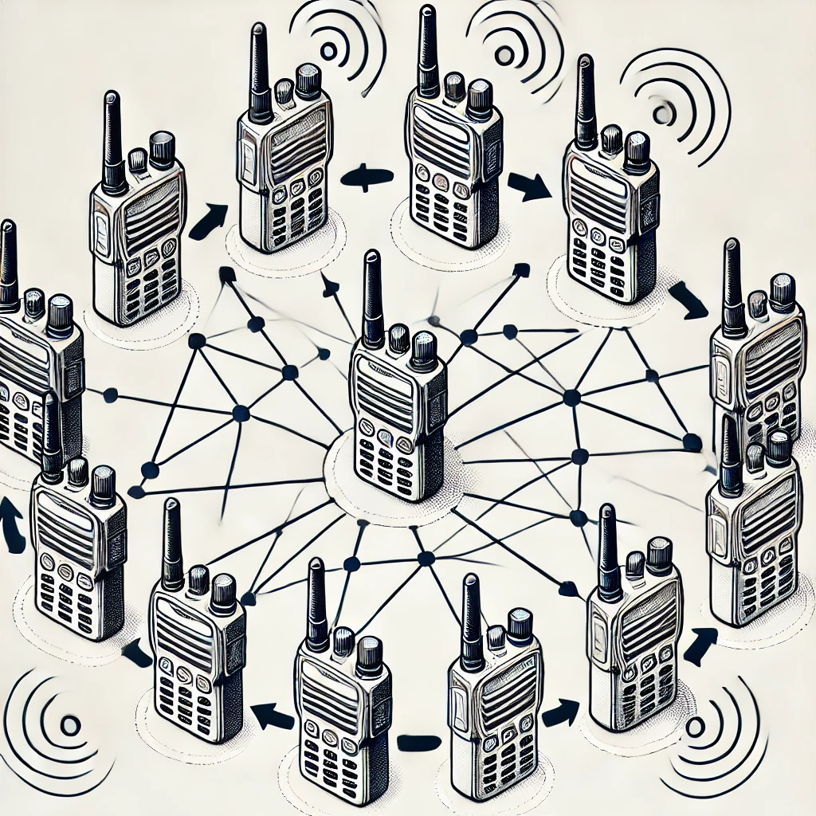
Project description
Problem statement: Conventional walkie-talkies face range limitations, requiring users to be within a fixed distance to maintain clear communication. This restricts operation in scenarios such as search and rescue, outdoor activities, or team coordination in large areas.

Slide 3
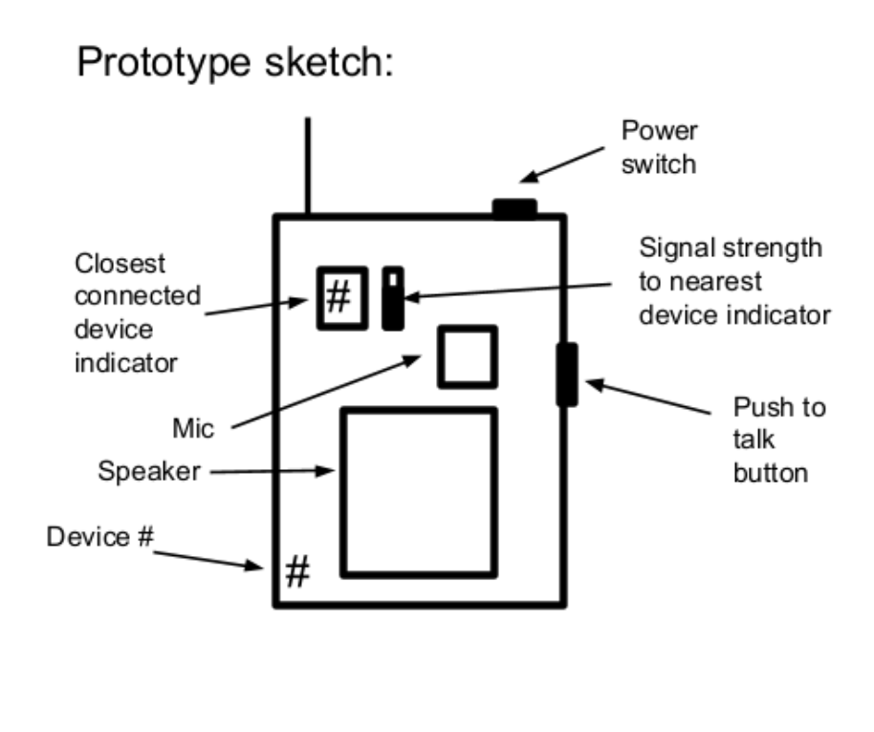
Project description
Solution proposal: Build a set of wireless, battery-powered walkie talkies that transmit/receive low latency audio between all devices using a connected mesh network to, when needed, relay the signal between devices that are too far apart to otherwise communicate.

Slide 4
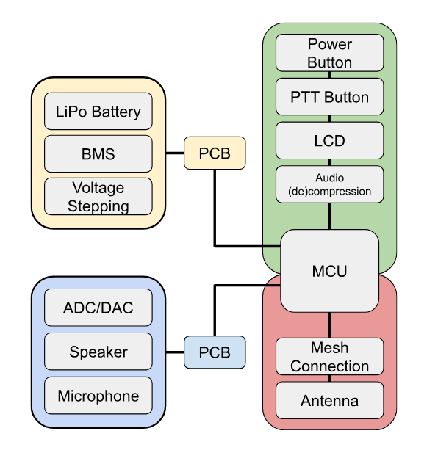
Subsystem & Interface Breakdown
Yellow: Junsu Yeo
Blue: Ryan Haag Green: Jaiah Steele
Red: Cole Cieslewicz

Slide 5

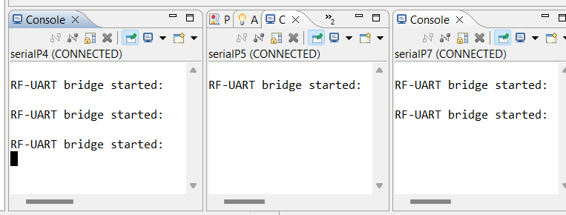
Wireless Mesh
Cole Cieslewicz
Accomplishments since the last presentation: 30 hrs | Ongoing progress/problems and plans until the next presentation
MCU Communication: One-way Tx/Rx b/t 2 devices (gibberish) One-way Tx/Rx b/t 3 devices in a mesh w/ text input Multi-way Tx/Rx b/t 3 devices w/ text input (not mesh) | MCU Communication Multi-way Tx/Rx b/t 3 devices in a mesh w/ text input Audio Transfer Integrating CC3200AudBoost’s audio packet buffer functionality to transmit buffers instead of text

Slide 6
Power System
Junsu Yeo
Accomplishments since the last presentation <30> hrs | Ongoing progress/problems and plans until the next presentation
Schematics Converters and LDOs Battery Charger and Protection Simulations Converters and LDOs | Routing All components are routed Need to edit some trace widths DRC passes with no errors Software for button press to get MCU to go into idle mode

Slide 7
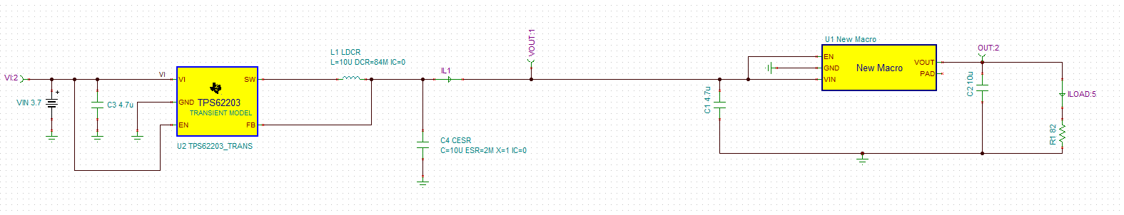
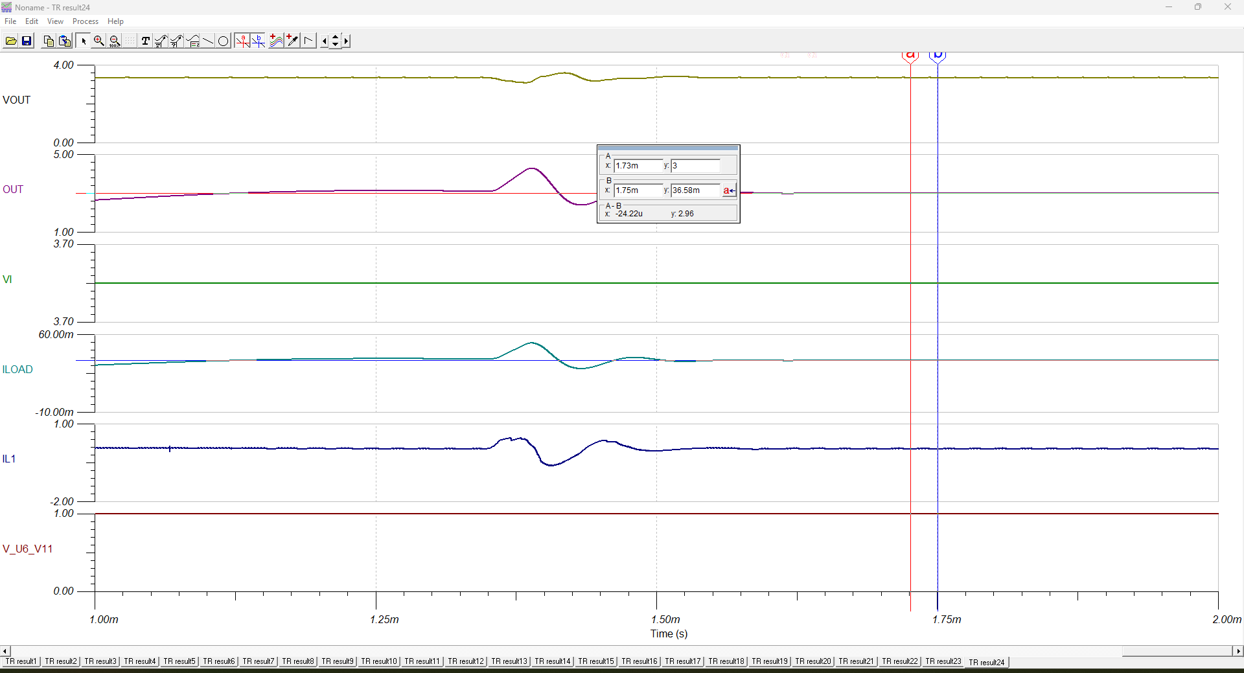
3.7V -> 3.3V -> 3.0V I_{L} = 36.5mA

Slide 8
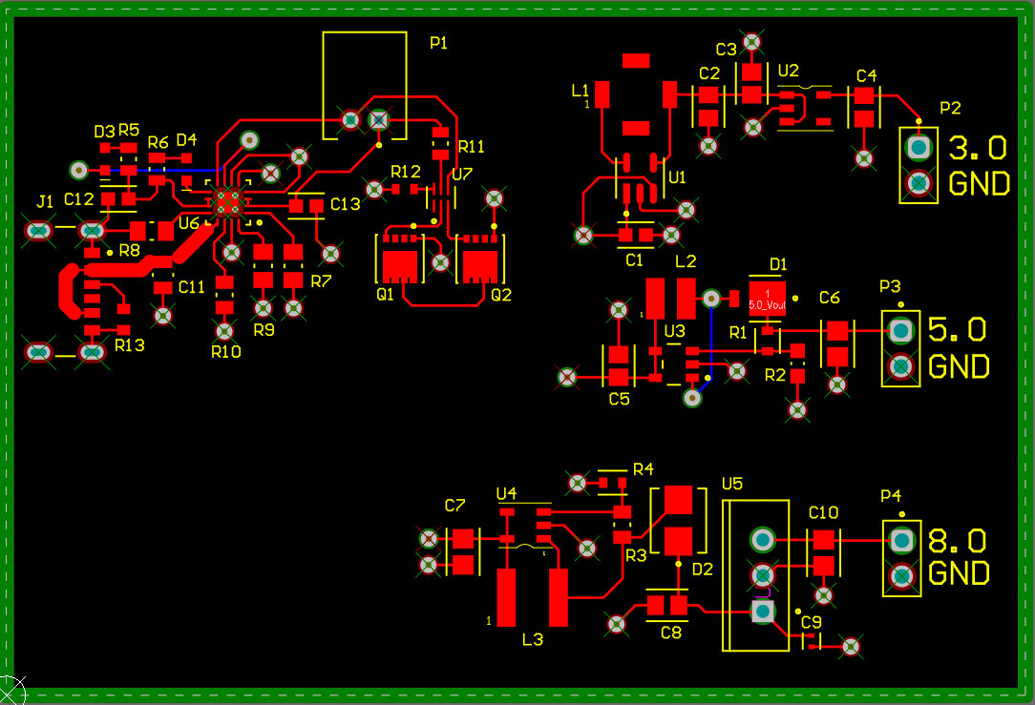

Slide 9
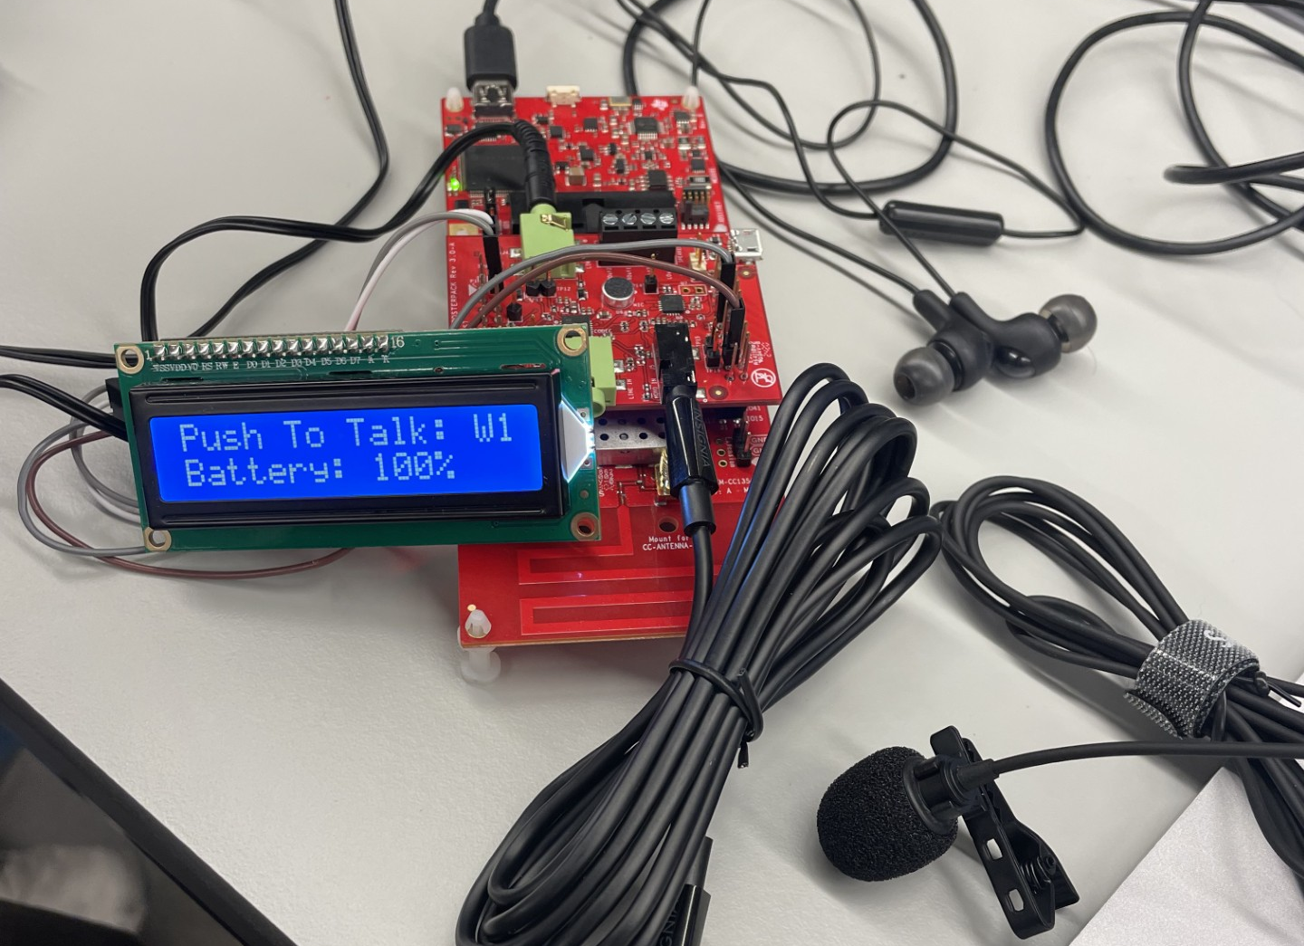
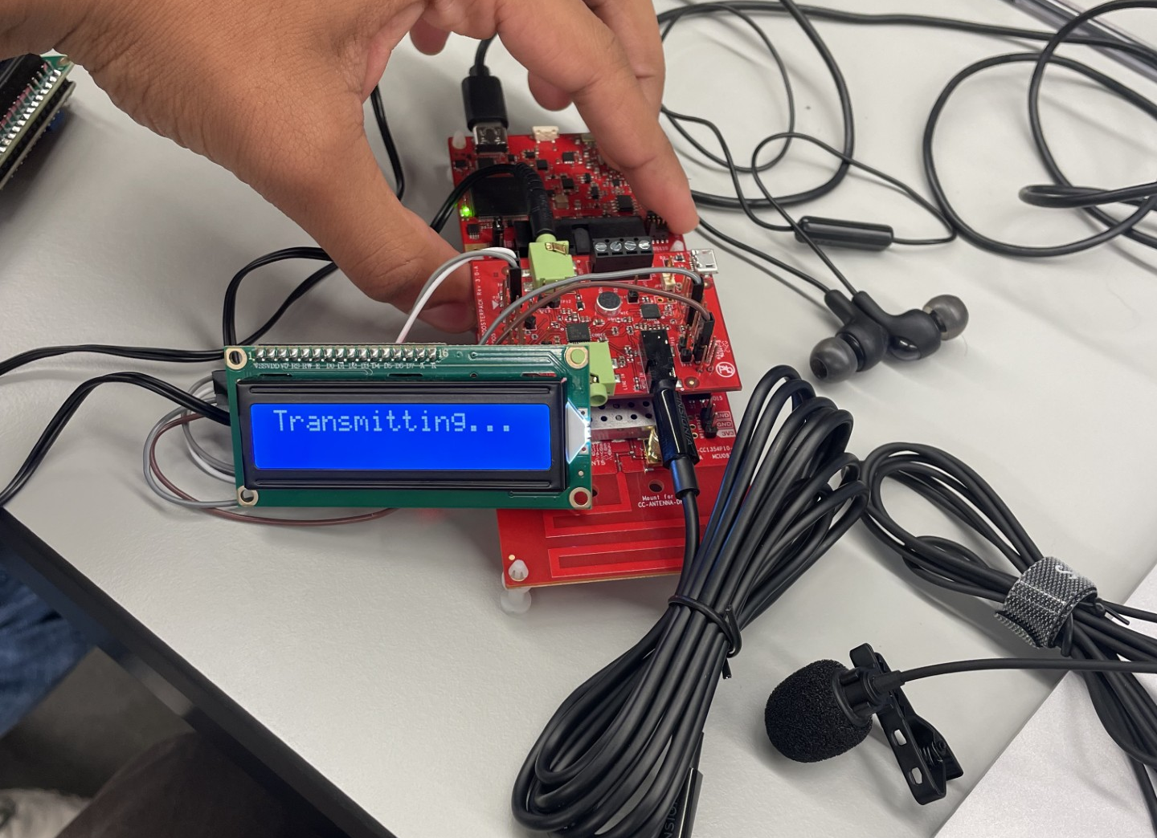
PTT/Audio Codec
Jaiah Steele
Accomplishments since the last presentation <30> hrs | Ongoing progress/problems and plans until the next presentation
Developed a LCD driver and successfully integrated it into the system Display now shows status messages Successfully combined LCD program with audio codec using the I2S protocol (works independently) The TLV320 on the CC3200AUDBOOST echos audio utilizing a noise filter to improve audio clarity | Switched from using the Opus codec to the ADPCM (Adaptive differential pulse-code modulation) SW codec for audio compression (simplicity, latency reduction) Plan to integrate my PTT button with I2S audio codec TLV320 and ADPCM Clean-up look with 3.5mm speaker/microphone

Slide 10
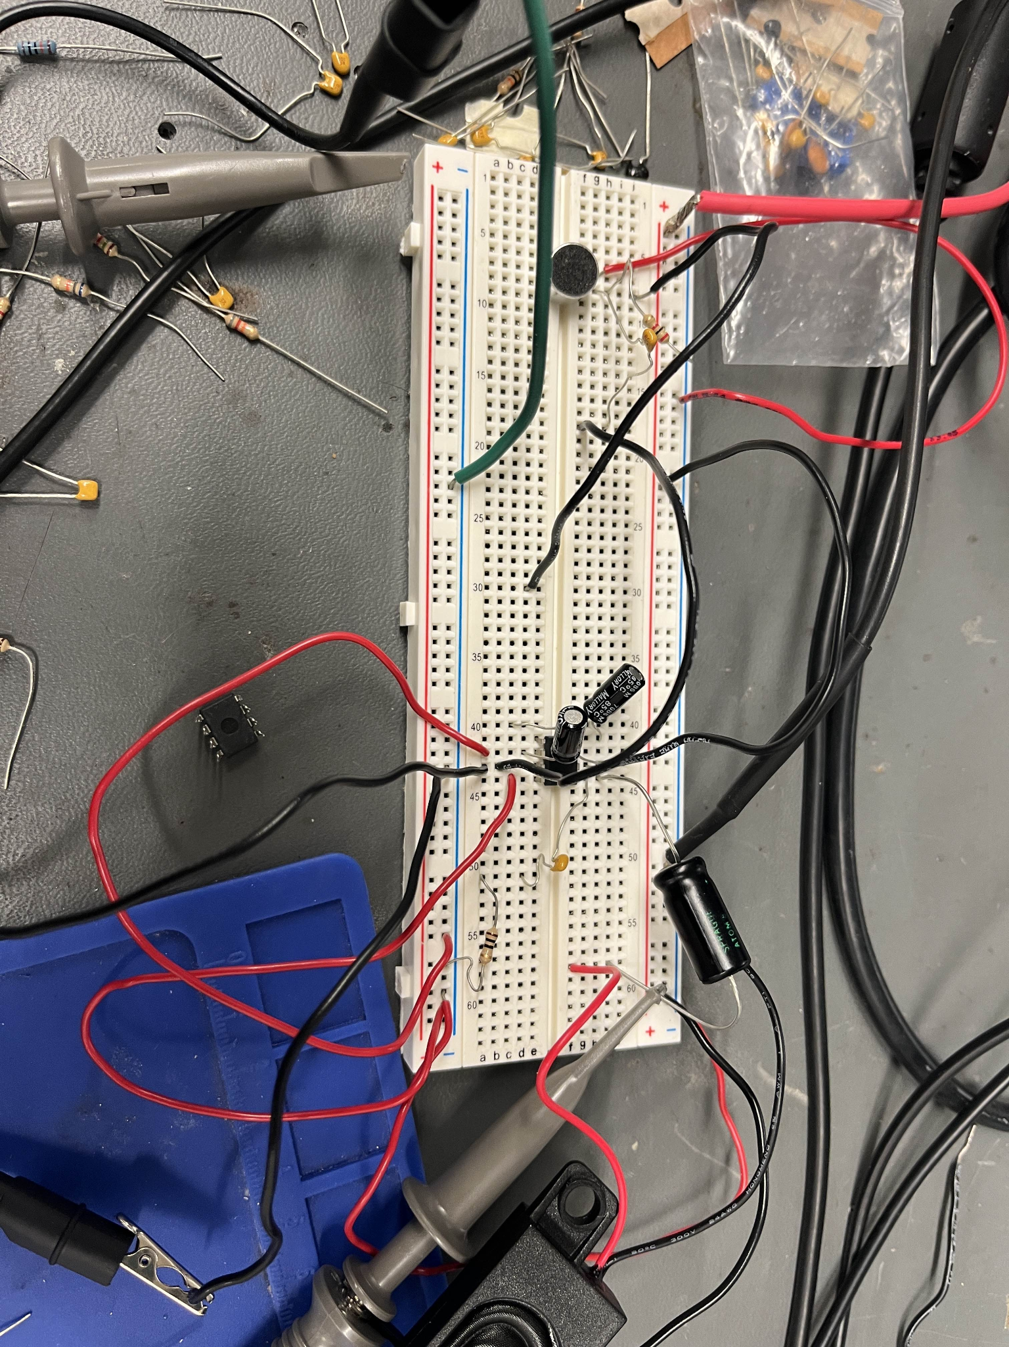
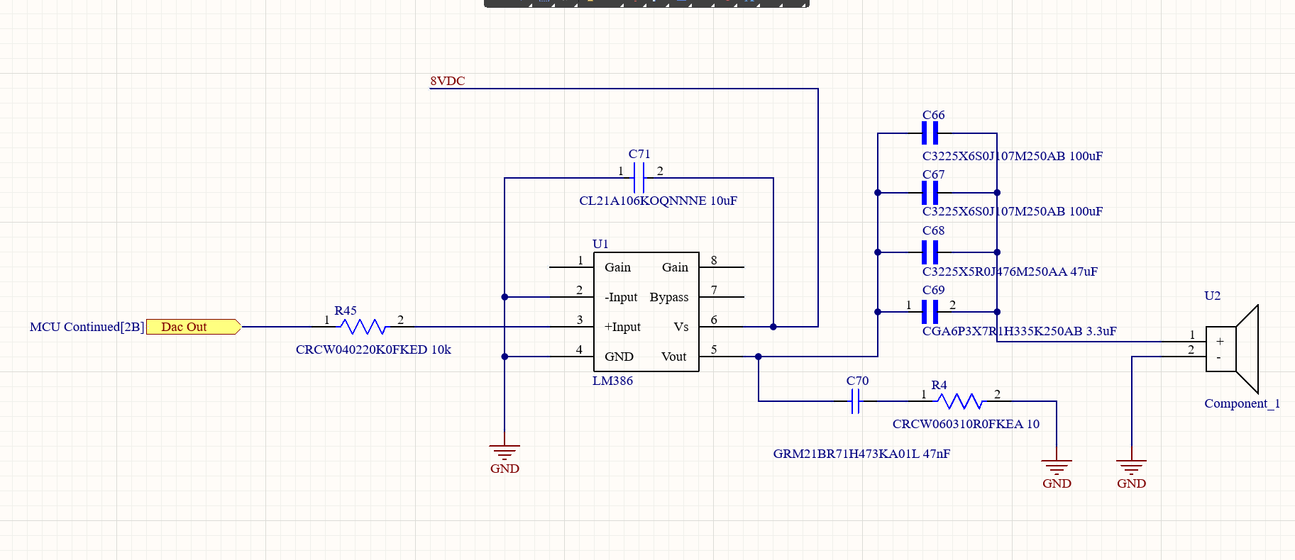
Audio Subsystem
Ryan Haag
Accomplishments since the last presentation 30 Hours | Ongoing progress/problems and plans until the next presentation
Was able to test the audio on a breadboard with the mic and speaker Began creating the schematics for the audio system and other components | Finishing up the PCB schematics and begin routing Begin working on the software for the ADC and DAC

Slide 11
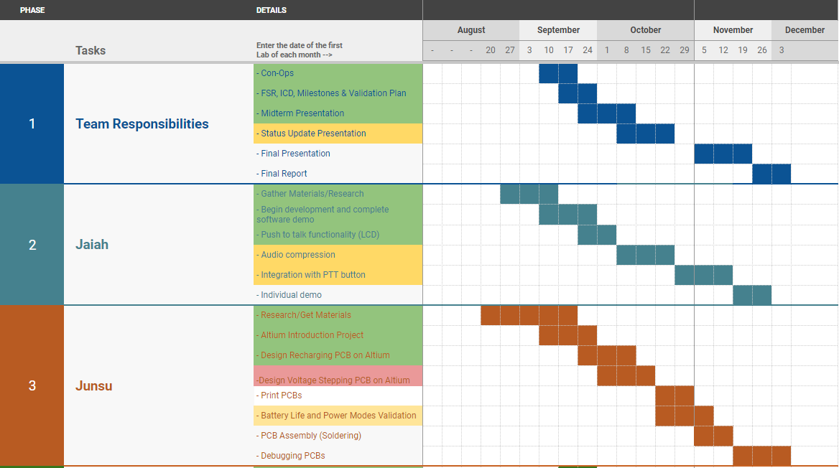
Execution Plan

Slide 12
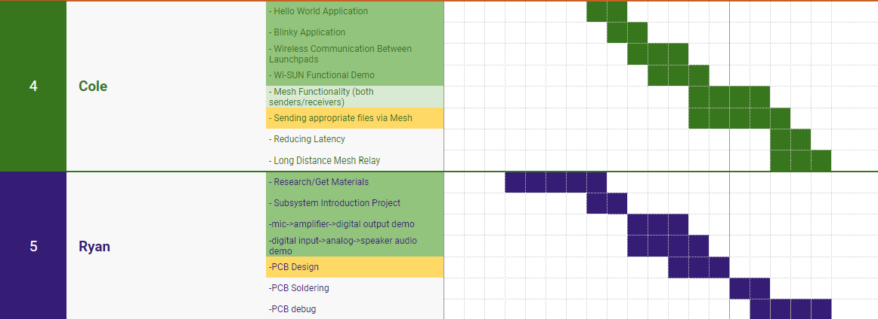
Execution Plan Cnt’d

Slide 13
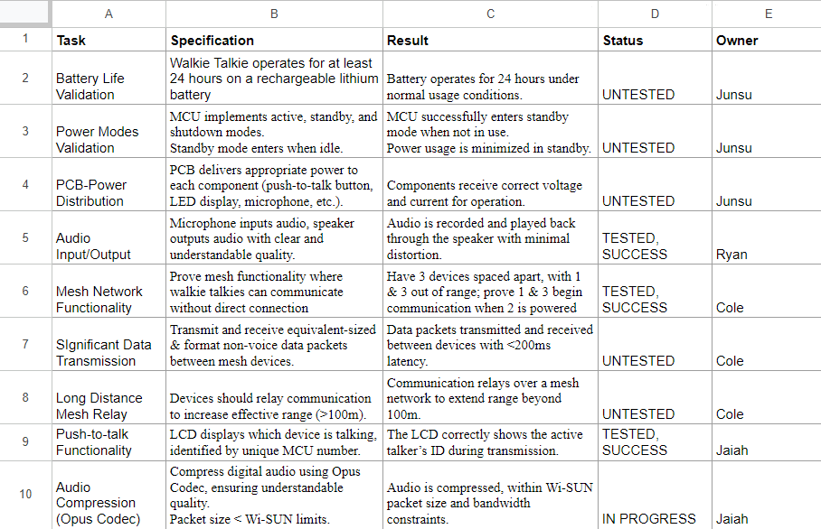
Validation Plan

Slide 14
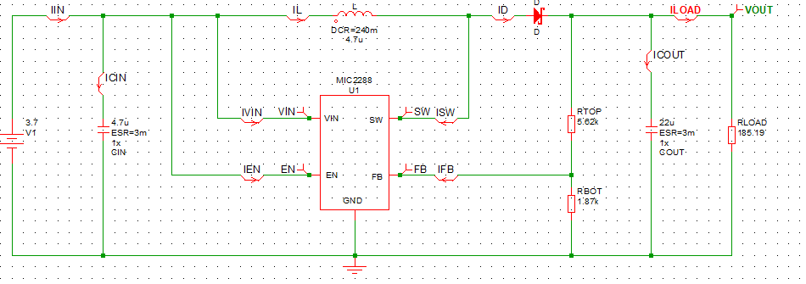
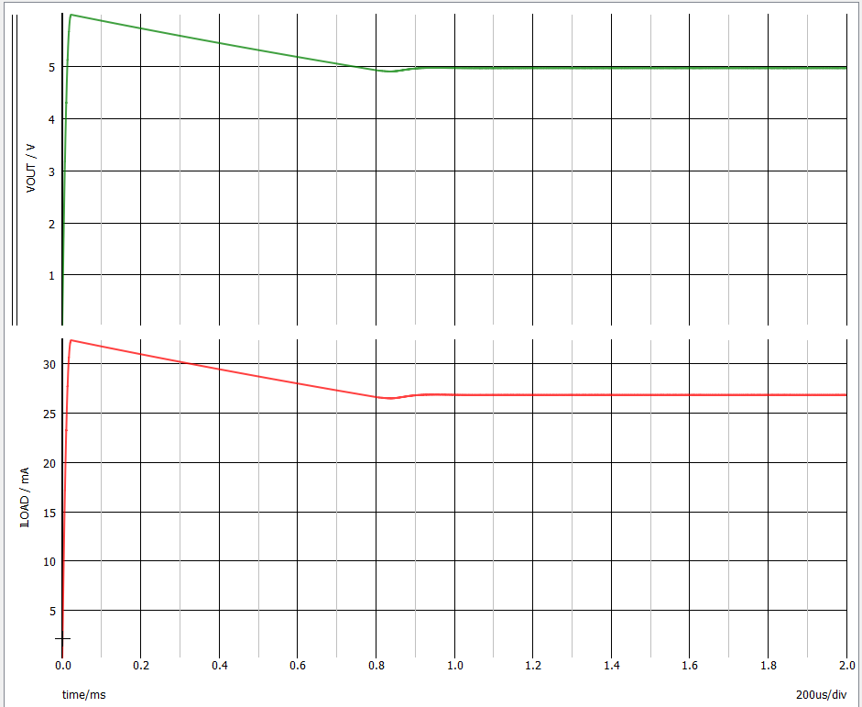
3.7V -> 5V I_{L} = 27mA

Slide 15
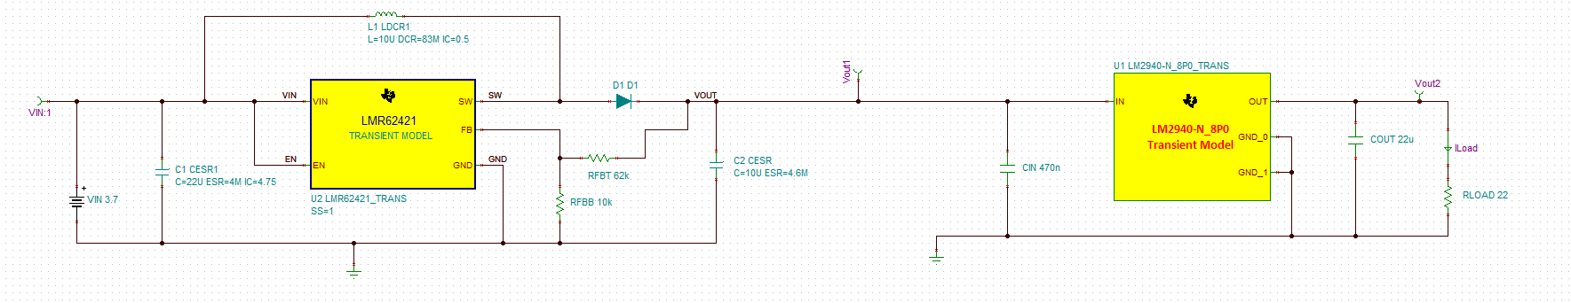
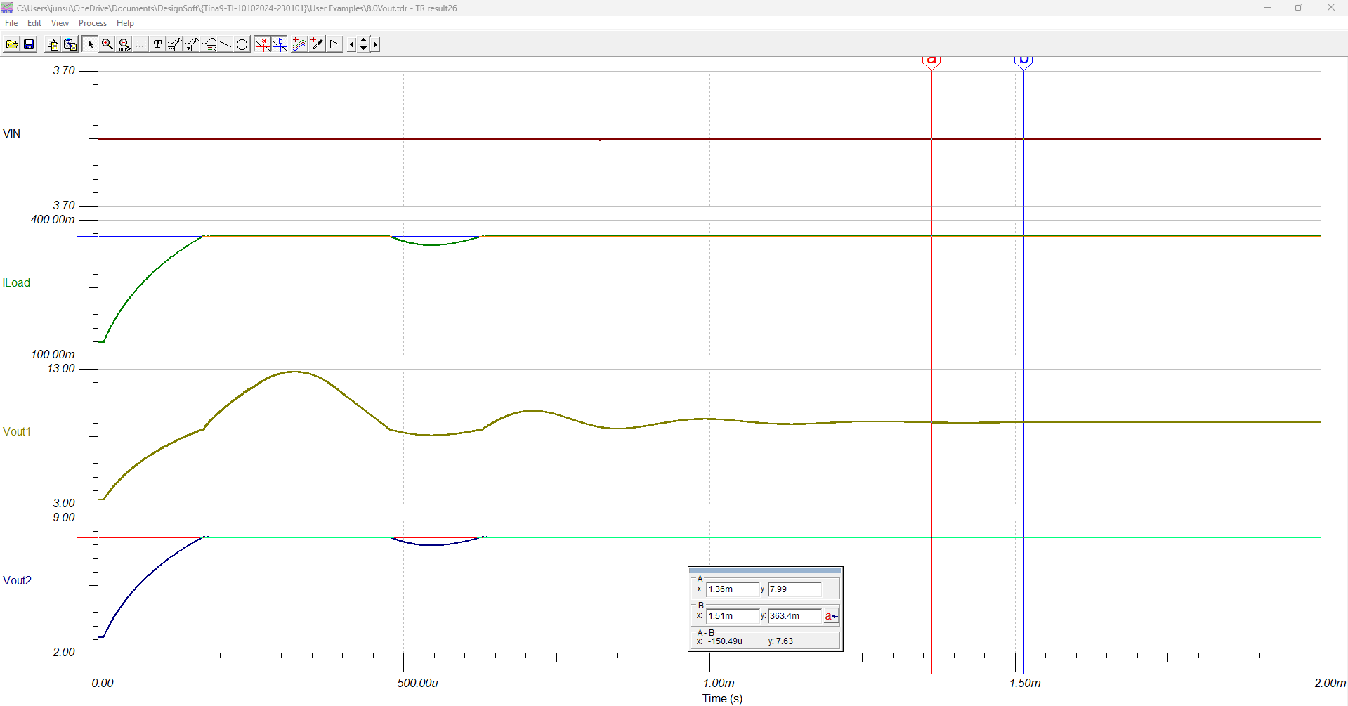
3.7V -> 9.06V -> 8V I_{L} = 363mA

Slide 16
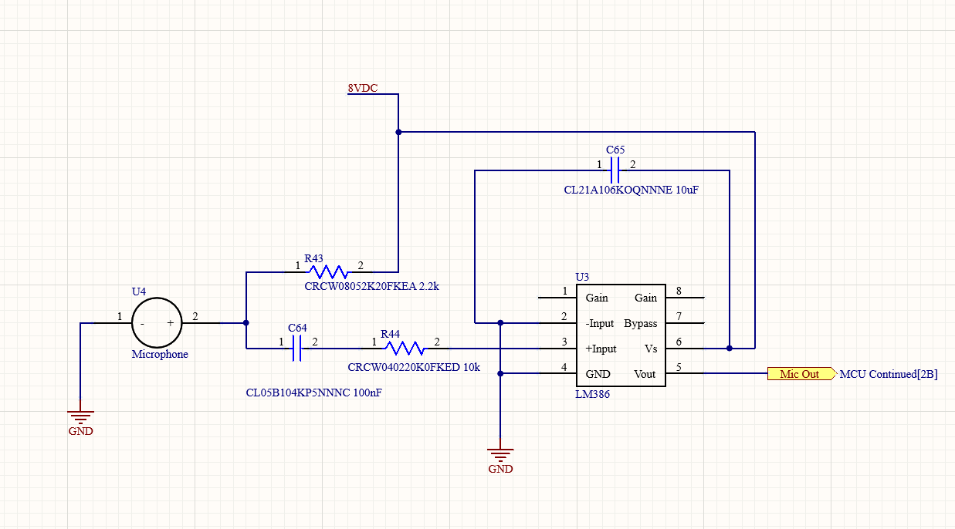
Mic Schematic

Slide 17
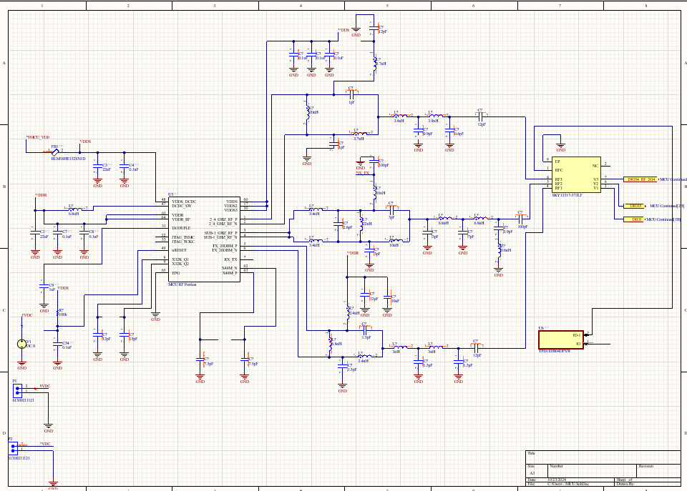
MCU RF Schematic

